Slide 1
Car Safety System
Matthew Tong -ICS2O

Slide 2
Purpose of Project
Provide a low cost solution
Demonstrate the capability of these low cost solutions
Make a fully modular system
Create new possibilities with these types of systems, so that they can do more with a small amount of resources needed

Slide 3
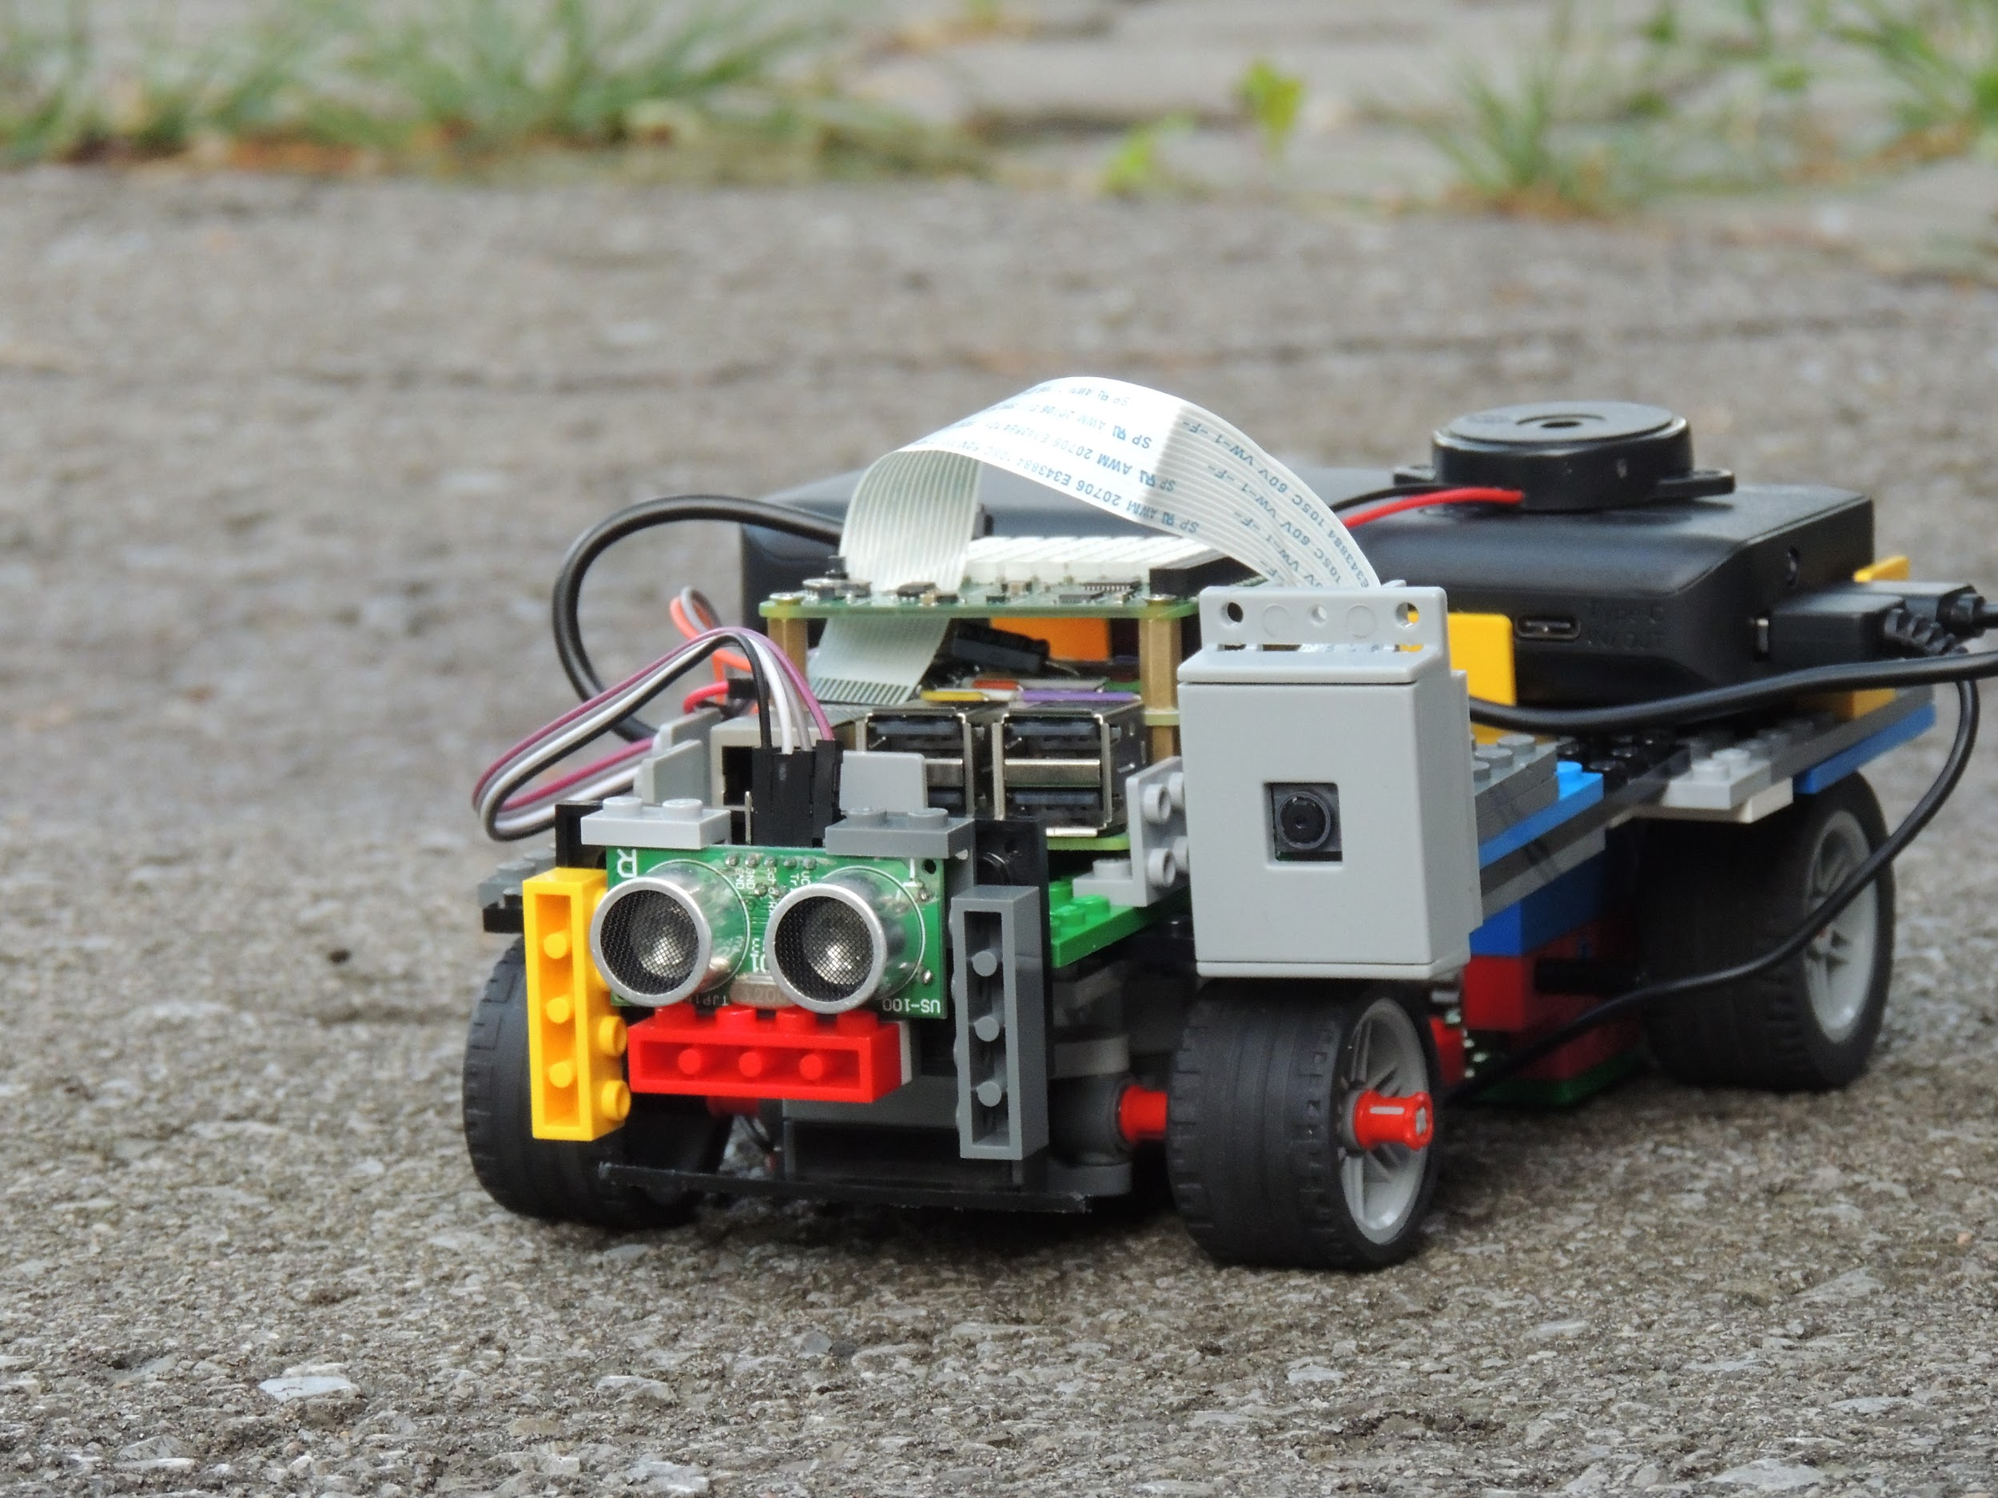
The Car
Battery Powered
Controlled by Raspberry Pi
Based off of LEGO Technic Car
But can run on any DC motor with positive and negative leads
Uses various sensors to perform constant checks for safety
Has auditory, visual, and physical feedback
Fully modular and controllable to different needs
An overall View

Slide 4
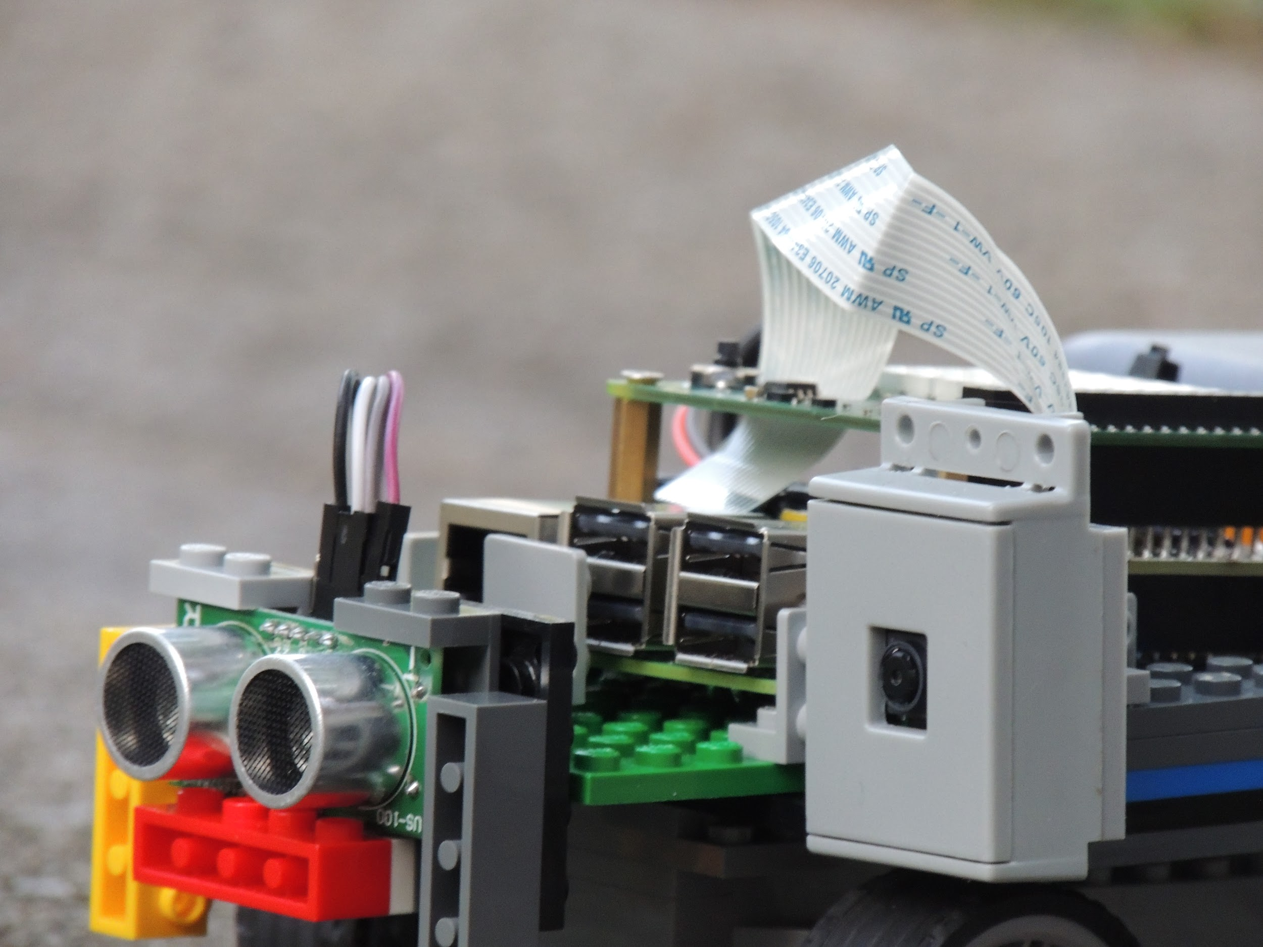
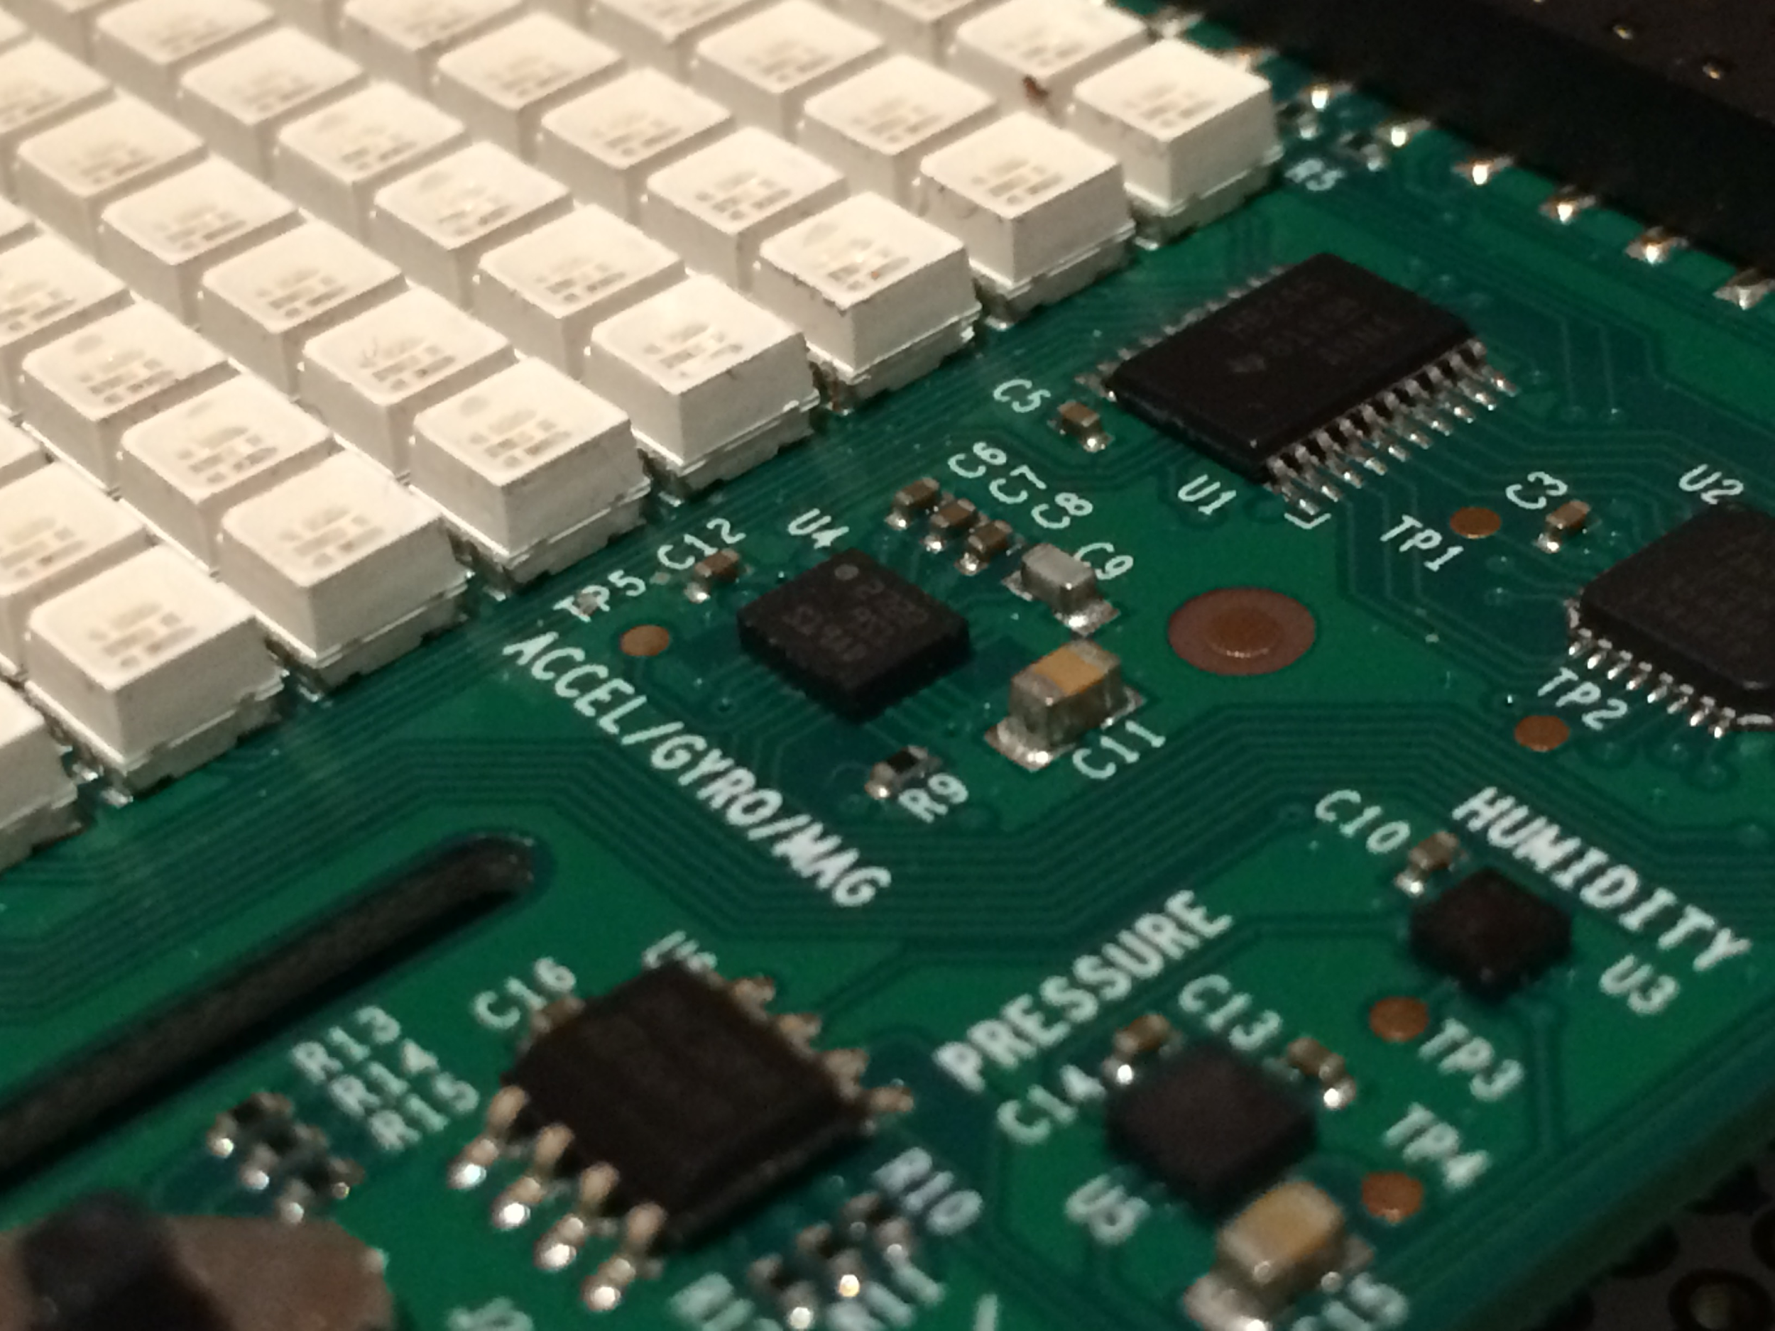
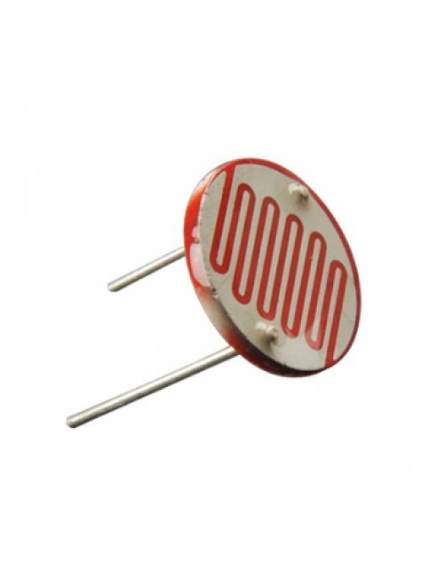
The Sensors (Environmental Input)
Ultrasonic Sensor to measure distances
SenseHAT IMU to measure incline
Photoresistor to enhance user feedback
Ultrasonic, IMU, PhotoResistor

Slide 5
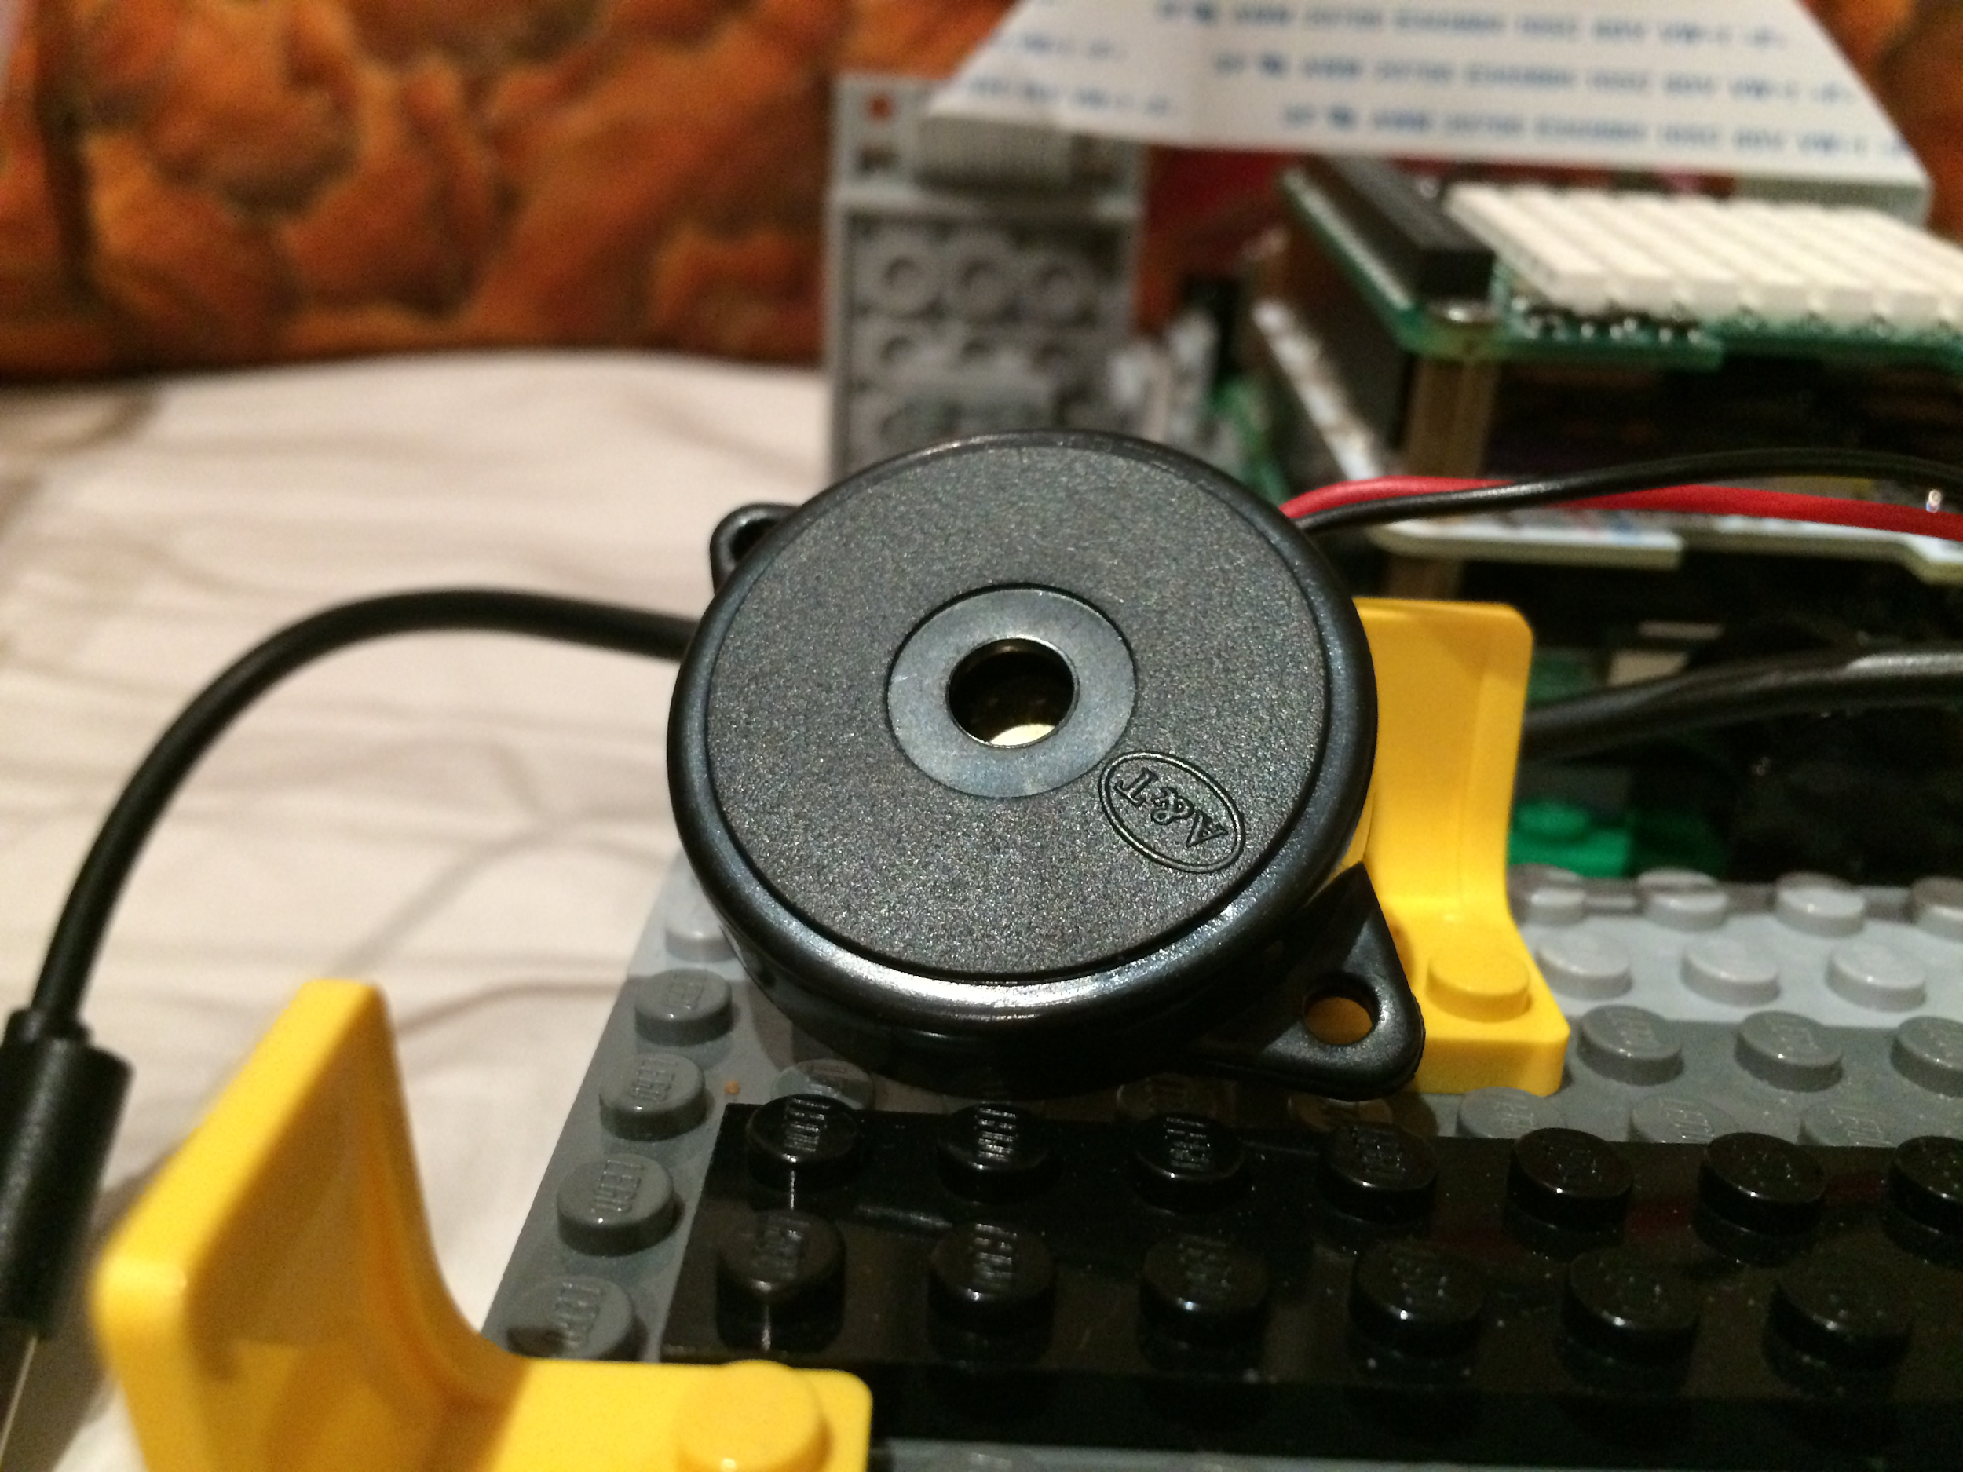
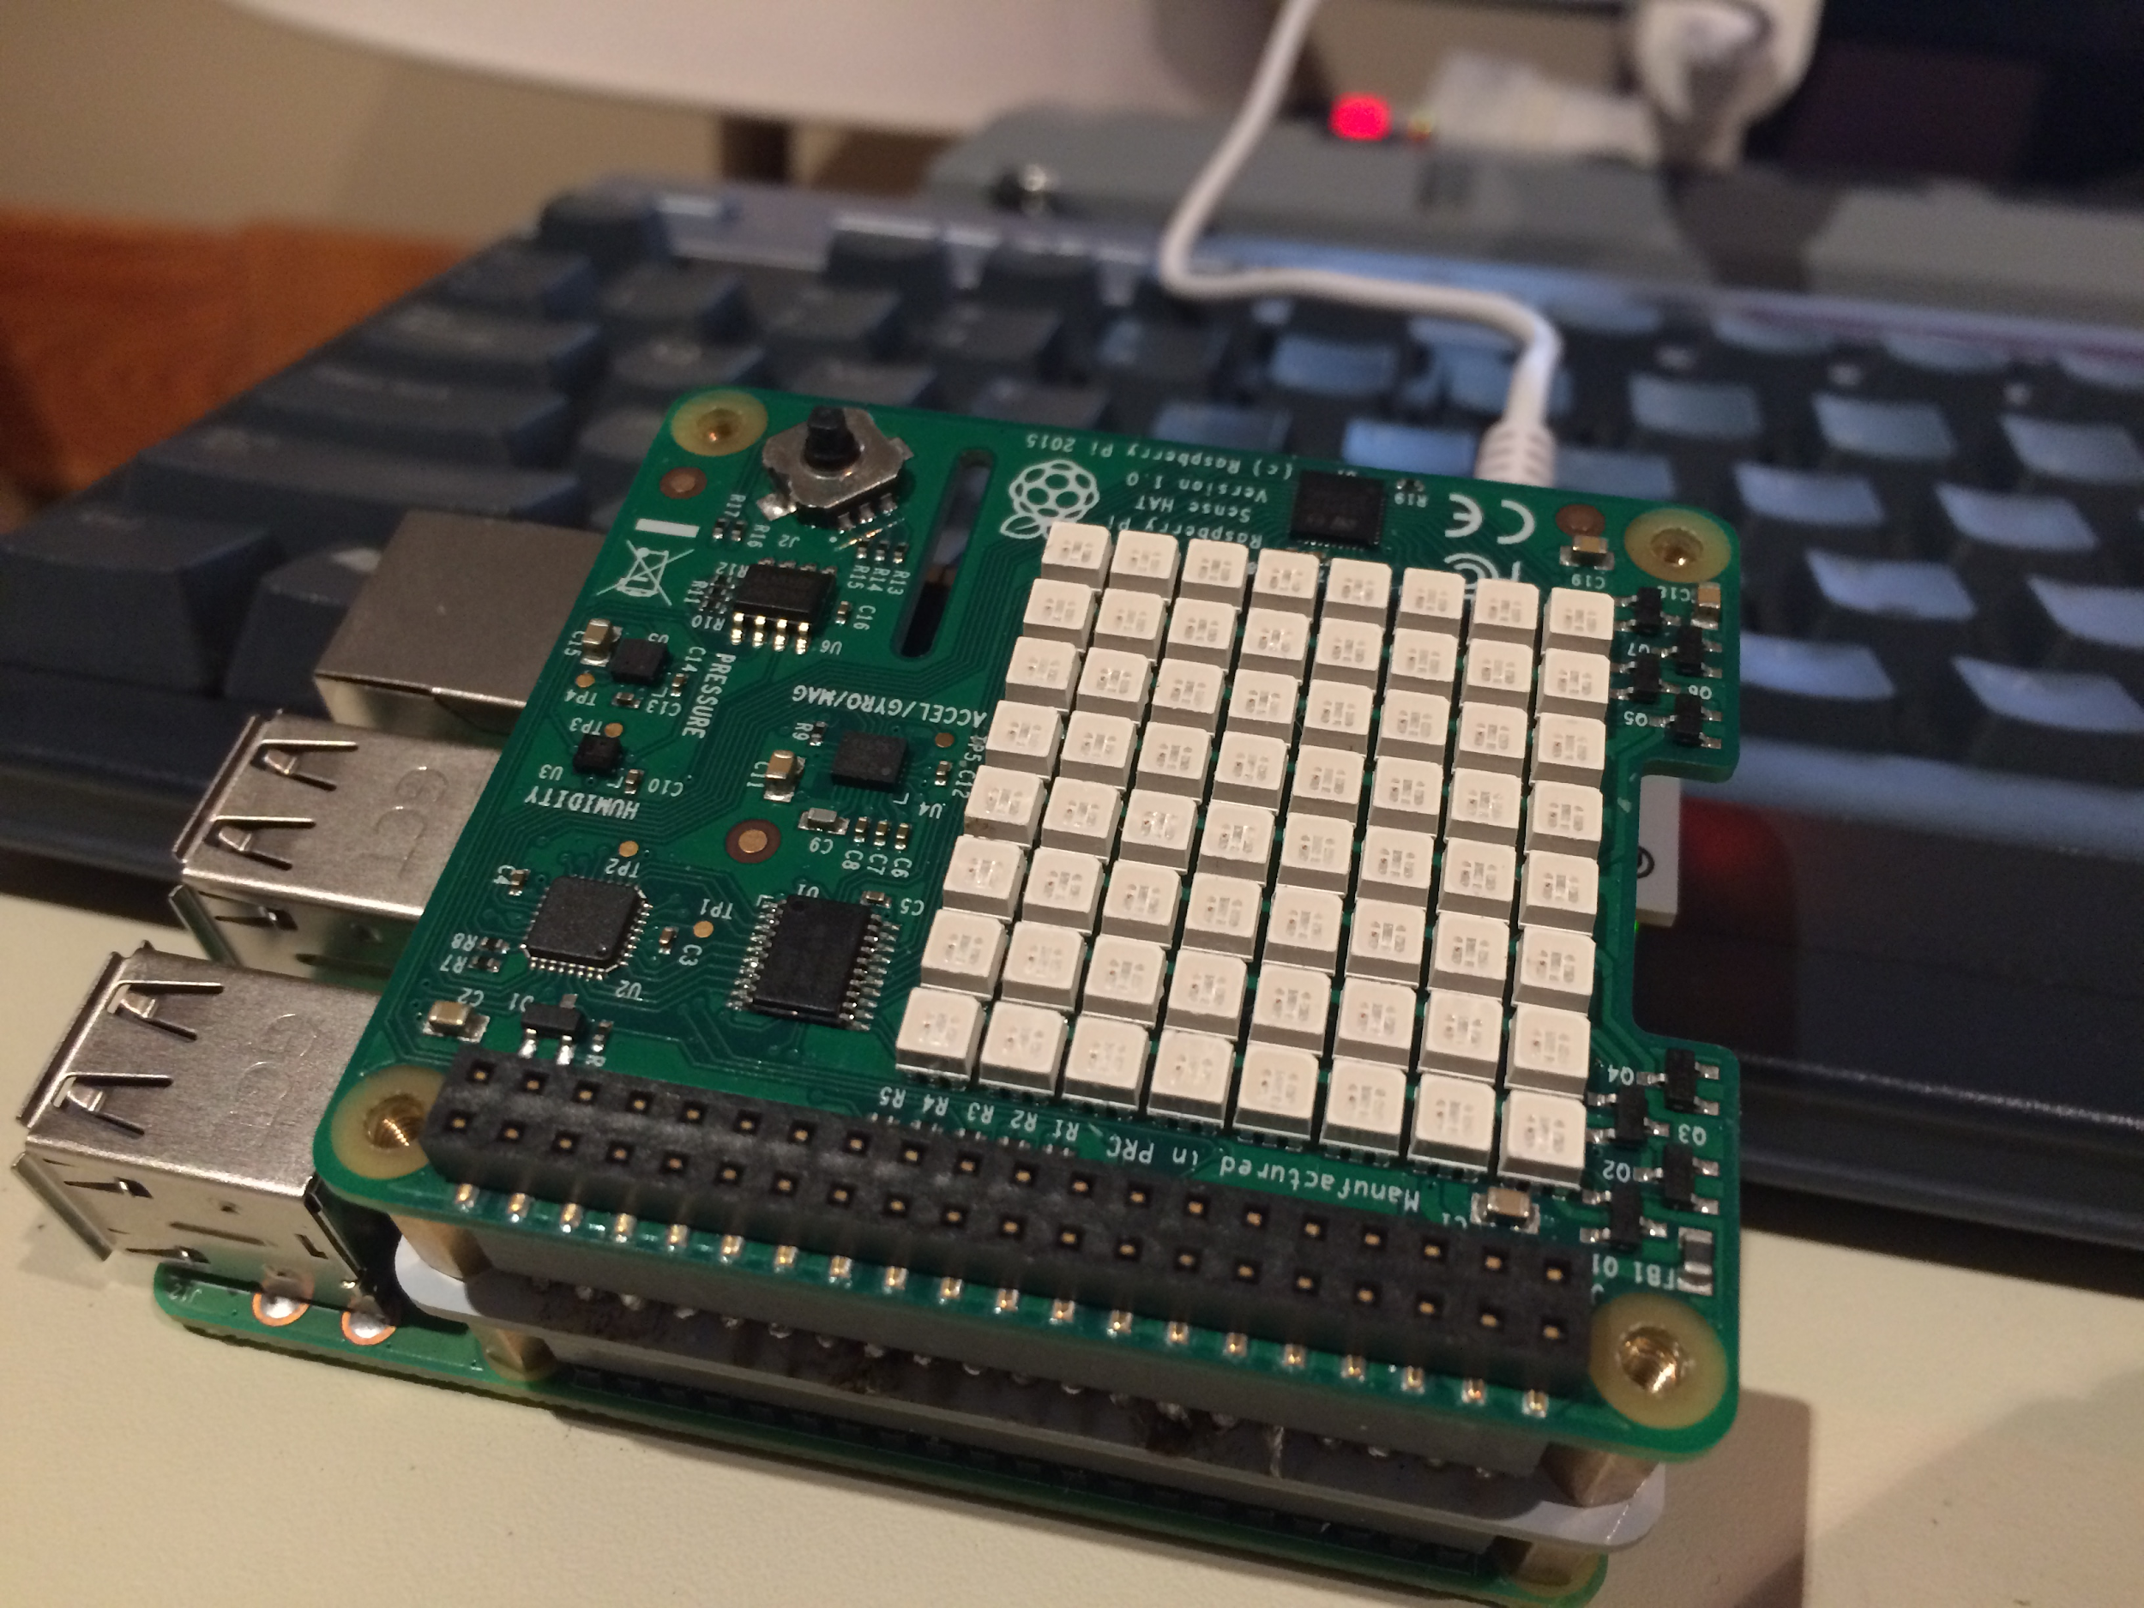
Feedback
SenseHAT LED Matrix, Buzzer, Power Interrupt

Slide 6
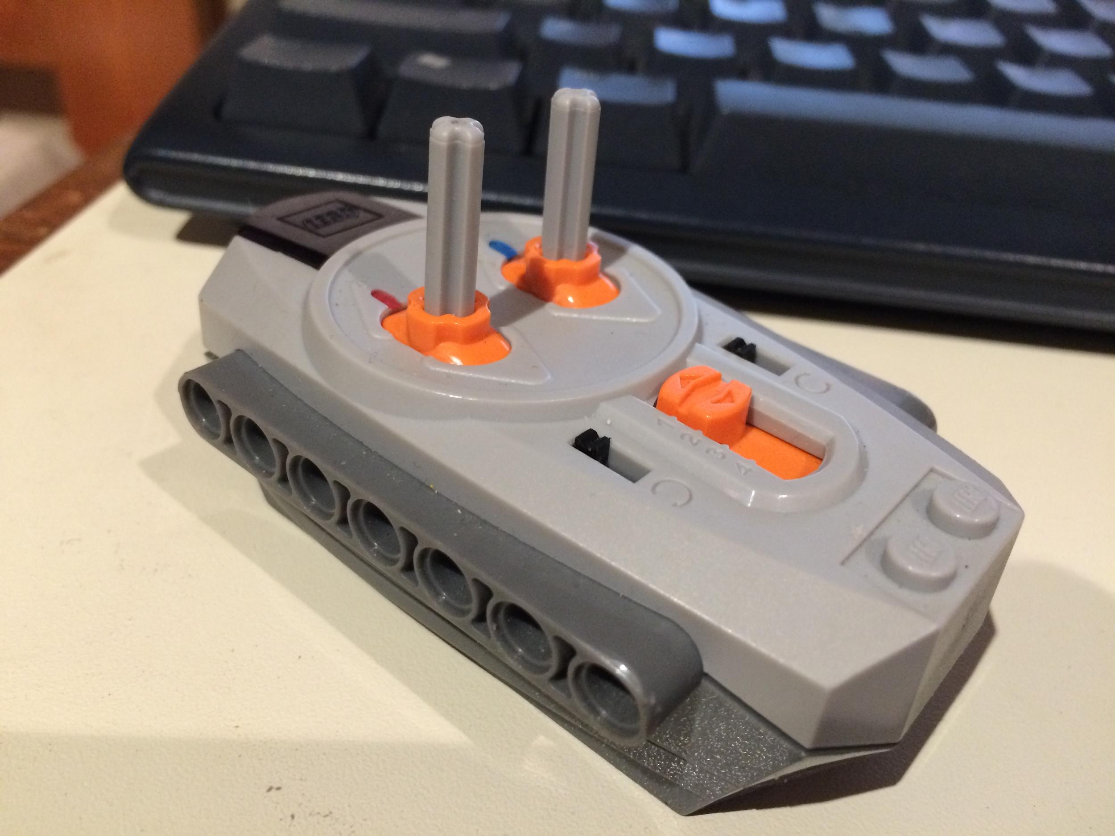
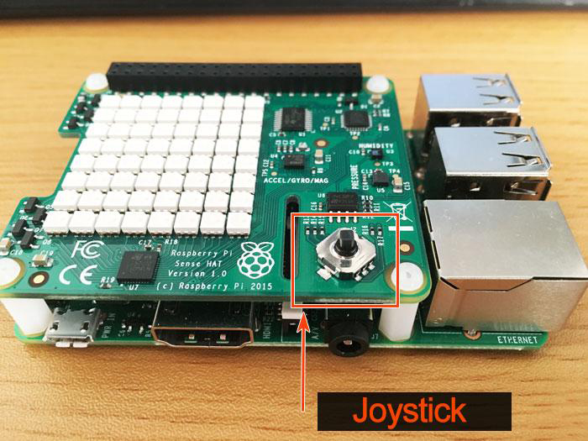
User Input
SenseHAT Joystick, Remote Controller

Slide 7
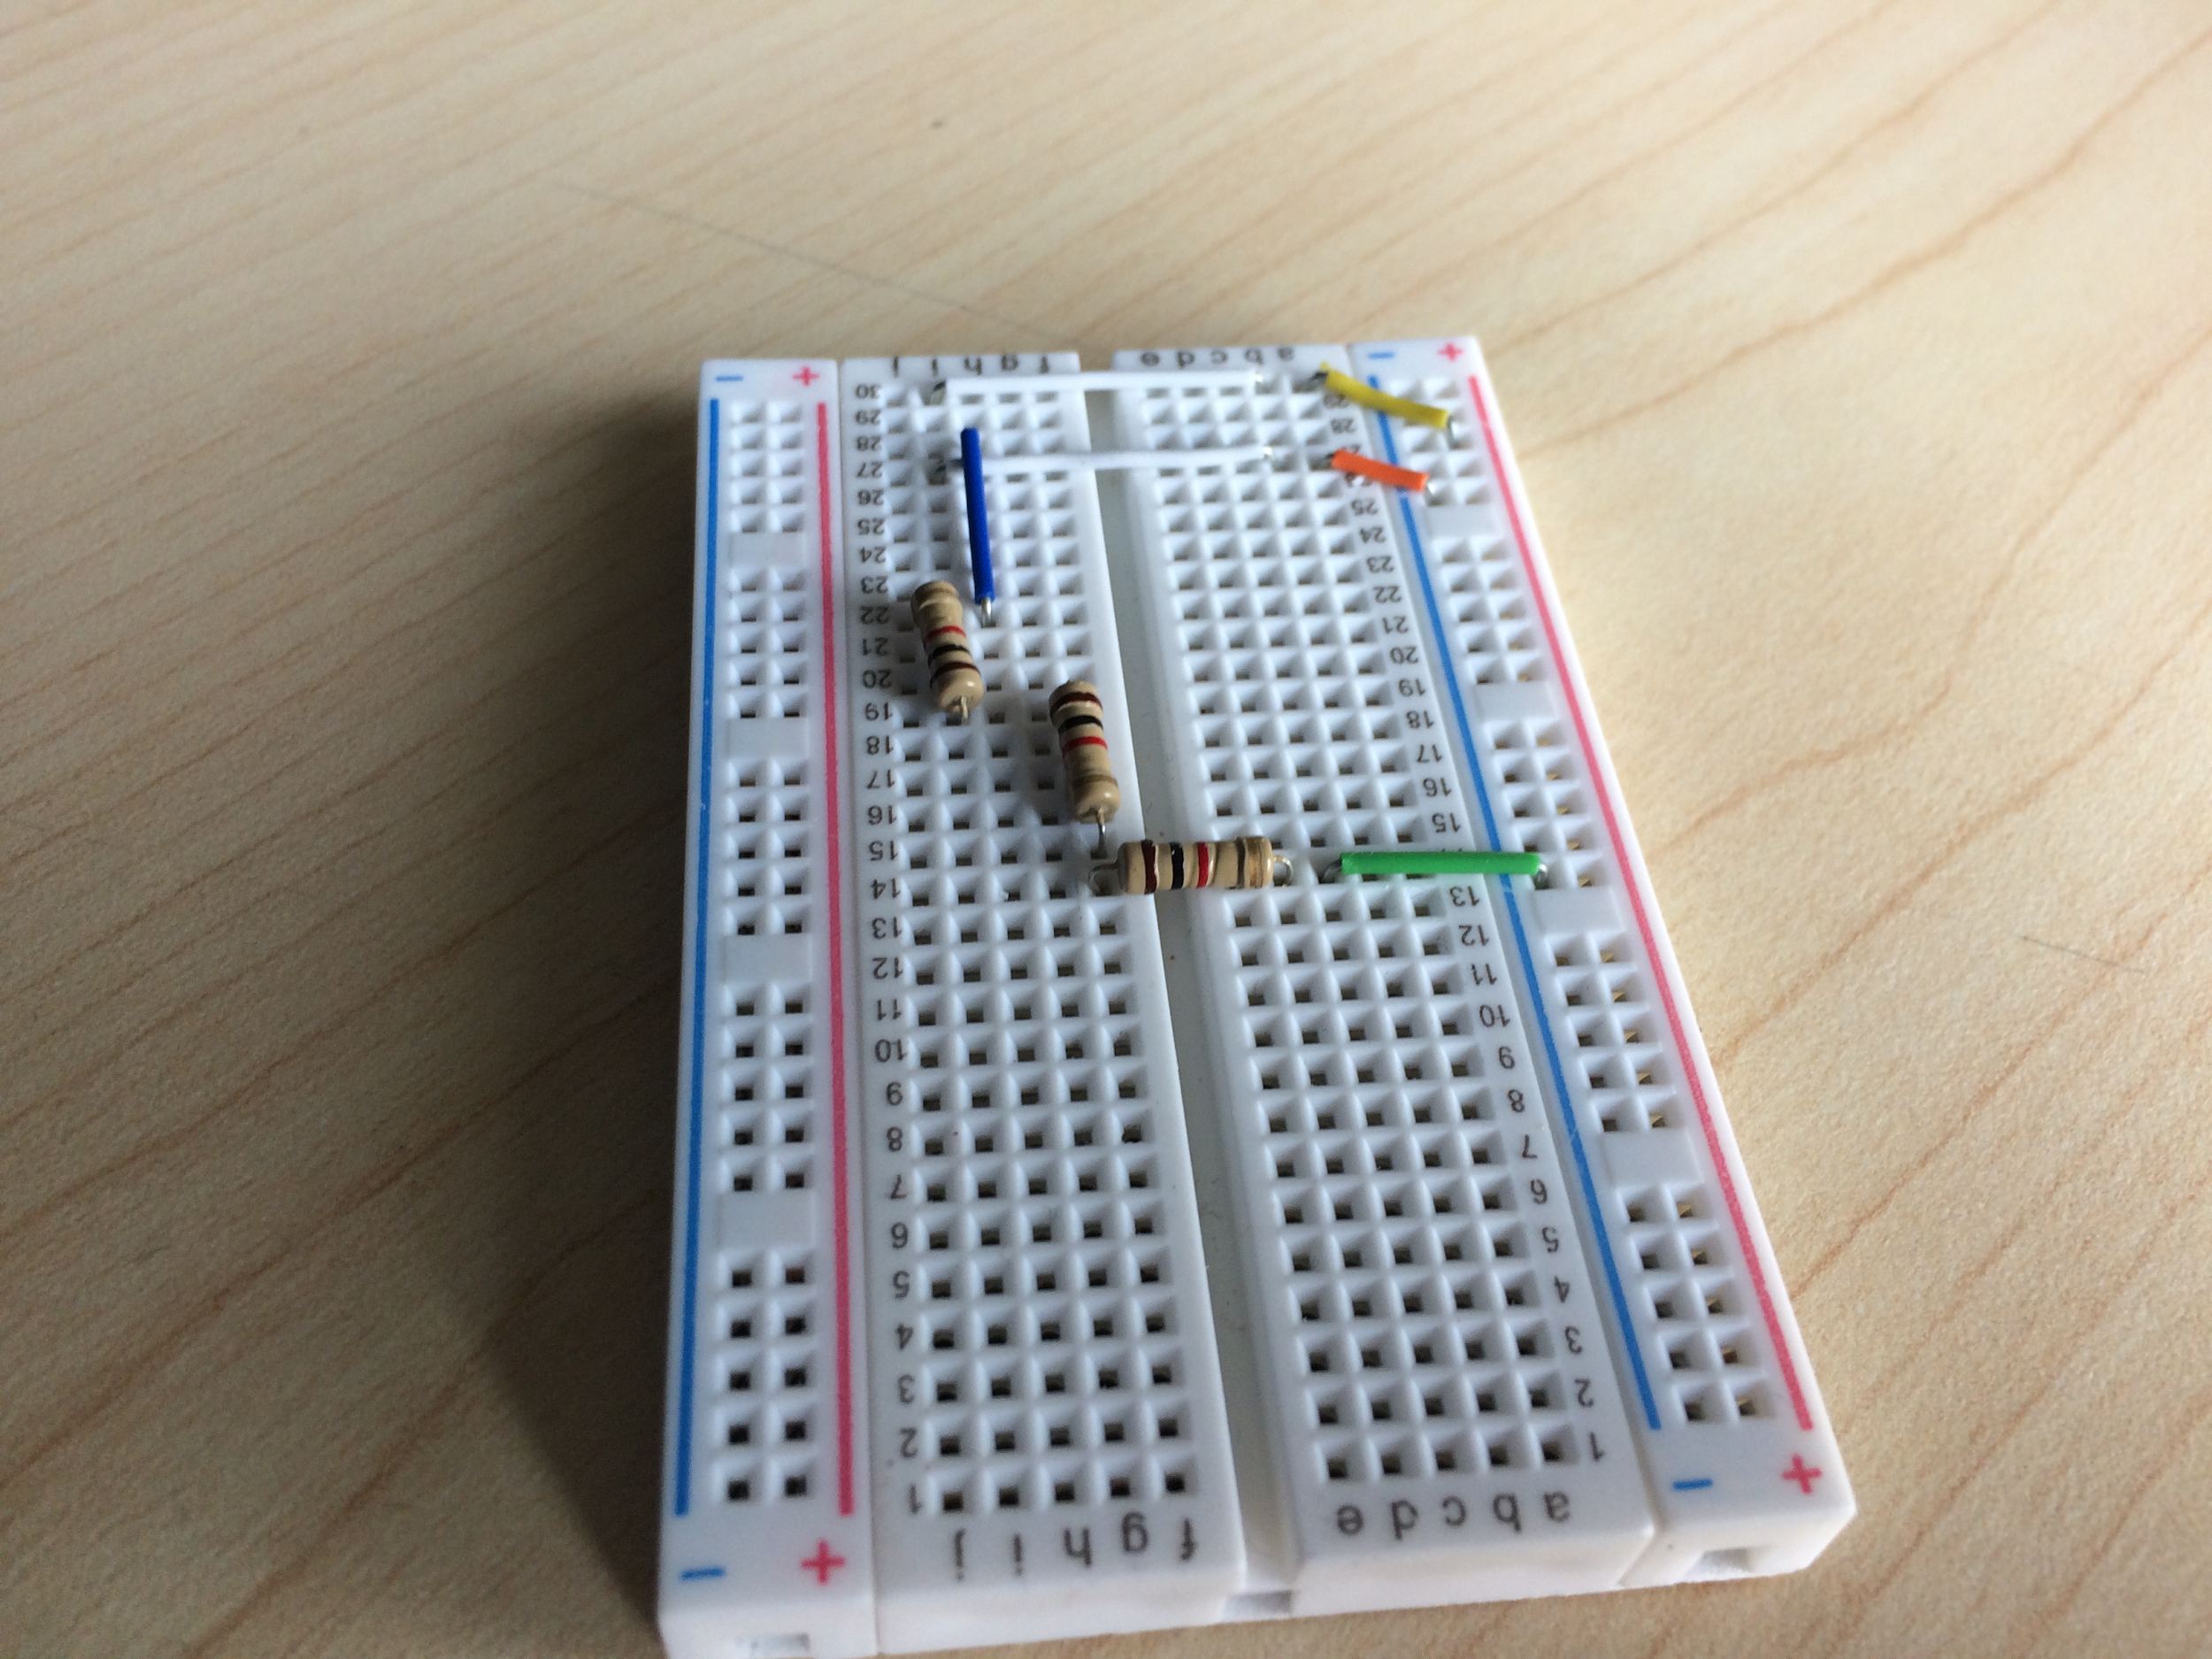
Major Difficulties
Power system: Finding the Right solution
Ultrasonic: Resistance and Circuit

Slide 8


Future Implementation
Uplink to AWS Rekognition
Utilize Cloud computing to run heavier programs
More intricate display
Remote reset button
Longer range

